Slide 1




A SENSOR-BASED DATA COLLECTION SYSTEM
A system that uses sensors to collect data from the environment or process.
creater
page 01
Bishal Pandey

Slide 2
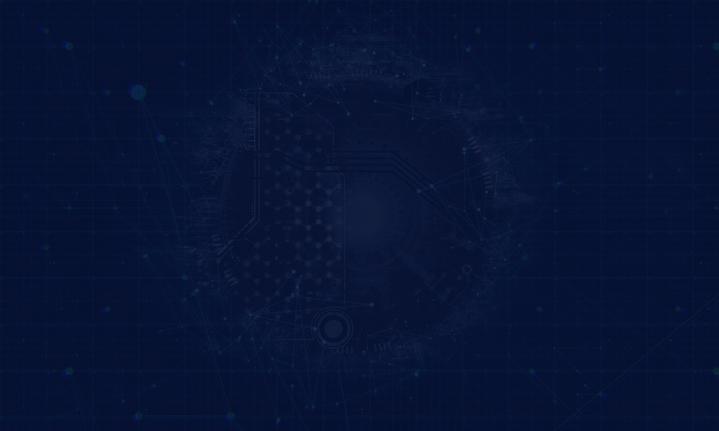

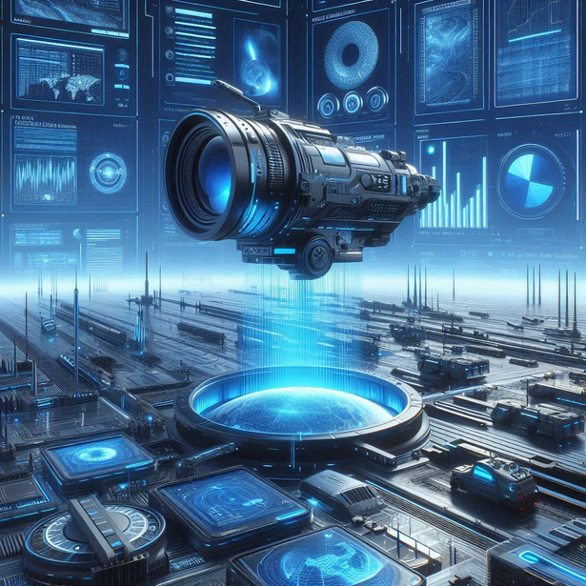
A system that gather data from the environment using sensors, which are devices that detect and measure specific physical properties. These sensors convert the data into digital signals and send it to a computer system or a central processing unit for analysis.
SENSOR-BASED DATA COLLECTION SYSTEM
Here are some example:
1. Smart city Traffic Management.
2. Environment Monitoring.
3. Healthcare Monitoring.
page 02

Slide 3

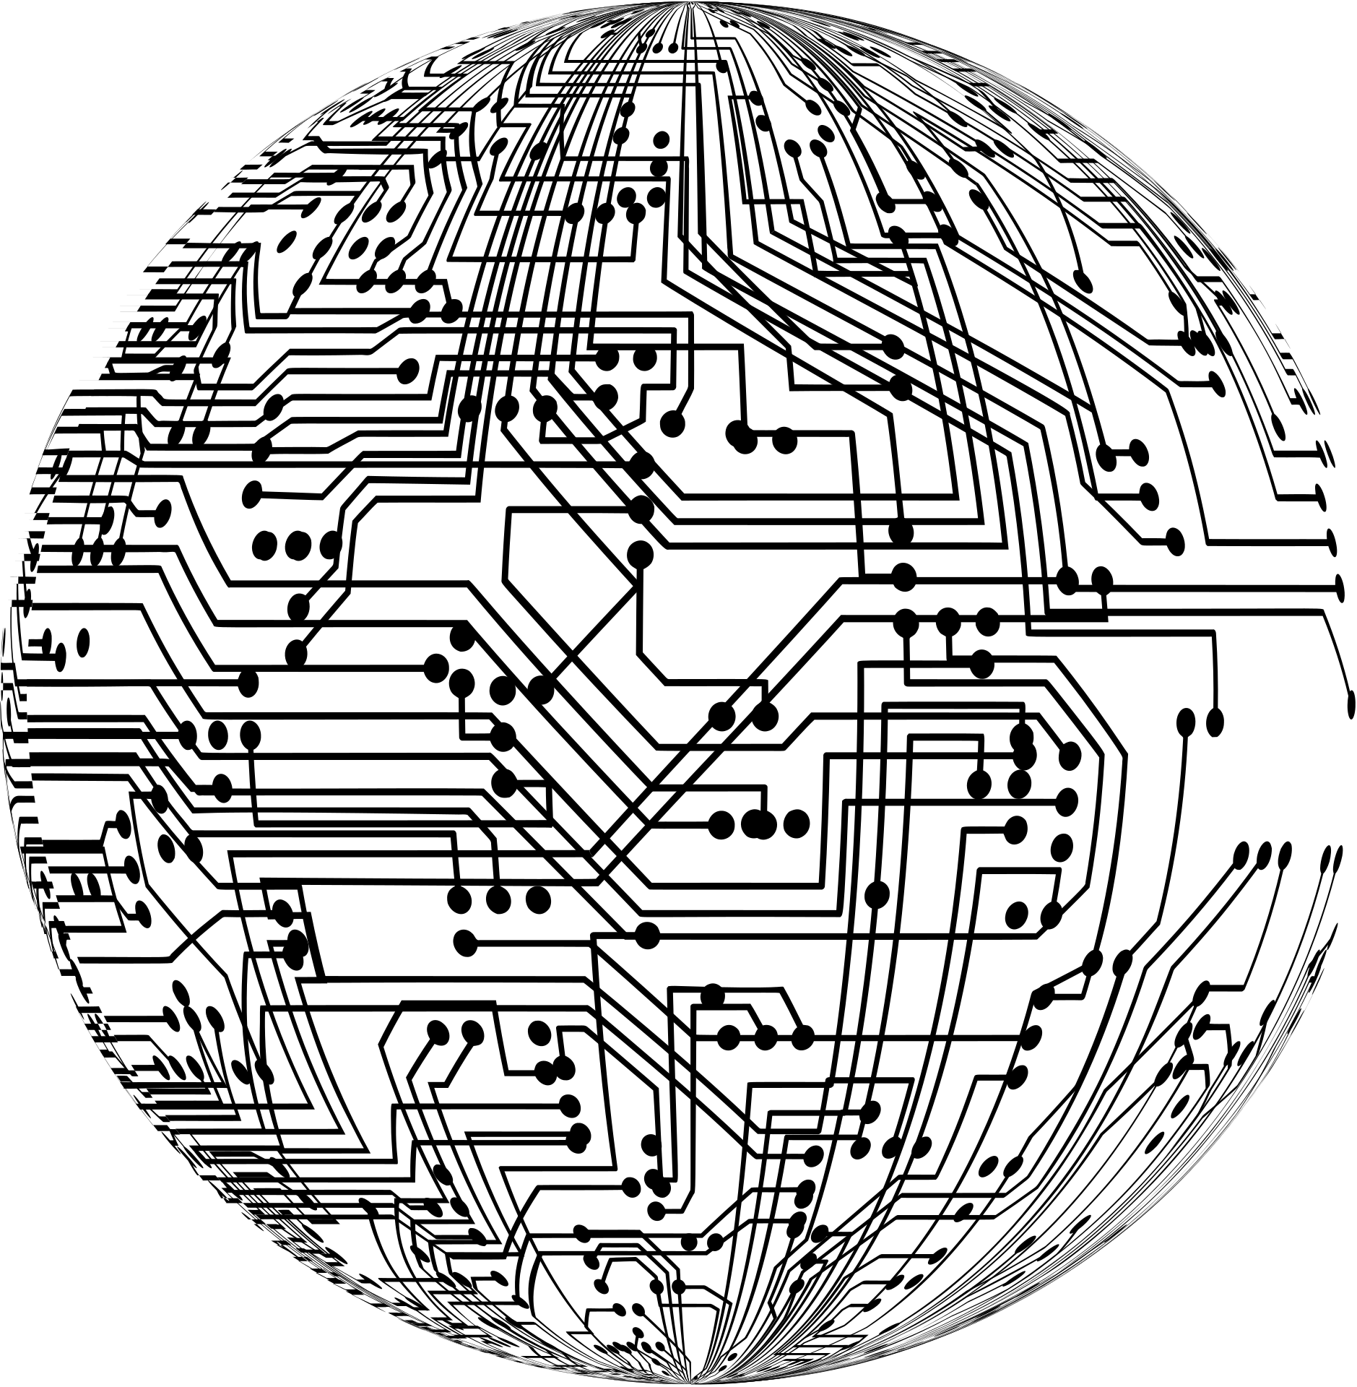

HOW DOES IT WORK
Sensors collect data.
Data is transmitted to a gateway or cloud.
Data is processed and analyzed.
Insights are displayed on a user interface (eg.:dashboard,mobile app).
Example:
Smart agriculture: Soil moisture => Cloud => Mobile app for farmers.
page 03

Slide 4



CHALLENGES
1.
2.
3.
Data security and privacy.
Integration of diverse sensors
Handling large volumes.
Different sensors use different communication protocols, making it hard to integrate them into a single system.
Sensors generate massive amounts of data, which can overwhelm storage and processing systems.
Sensitive data collected by sensors can be vulnerable to hacking or unauthorized access.
page 04

Slide 5
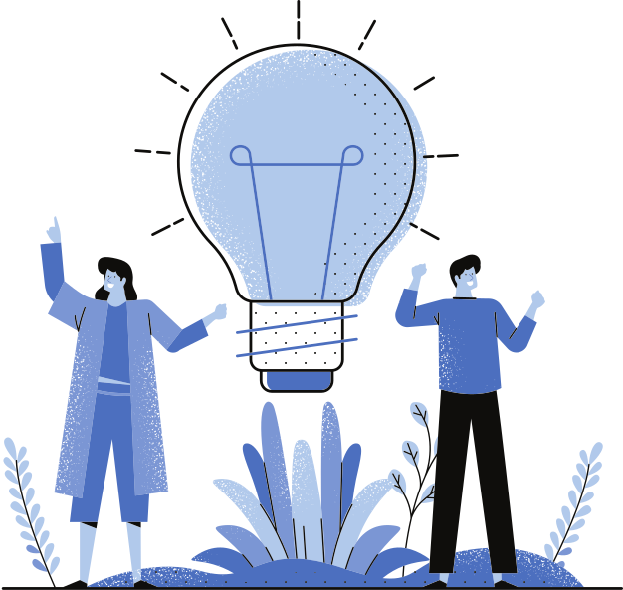


SOLUTIONS:
1.
Encryption
Use secure communication protocols to protect data.
2.
Standardized Protocols:
Adopt Common protocols like MQTT or CoAP for seamless integration.
3.
Edge Computing:
Process data locally (at the edge) t0 reduce latency and cloud dependency.
page 05

Slide 6
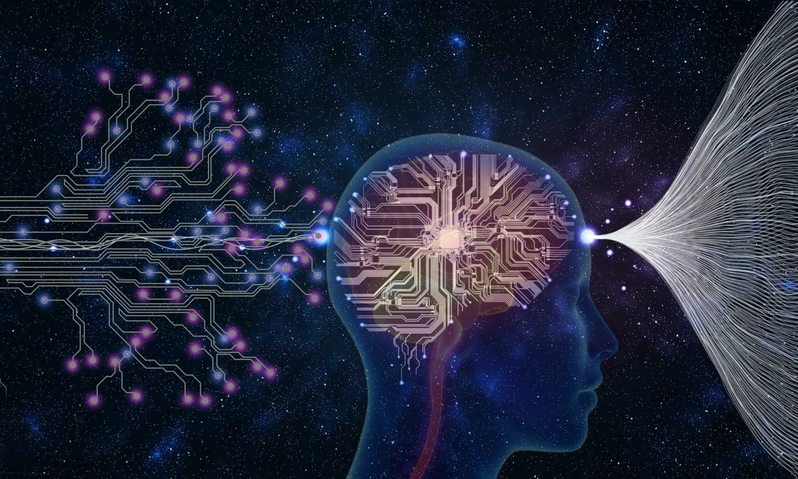
CONCLUSION
Sensor-based data collection system are transforming industries by enabling real-time monitoring and smarter decision-making. From agriculture to healthcare, they improve efficiency and reduce costs. Challenges like data security and integration are addressed through encryption, standardized protocols, and edge computing, With advancements in Al, 5G, and blockchain, these systems will continue to evolve, driving innovation and connectivity in a data-driven world.
page 06

Slide 7

THANK YOU!
As we look to the future, these technologies will play a crucial role in shaping a better world for generations to come.
page 07

